Slide 1
Purpose for Parenting
1. Glorify God – 1 Cor. 10:31
2. Disciple kids to Christ.
3. Be an instrument/tool in what God wants to do in a child.

Slide 2
Heart of a Child
1. Brought forth in iniquity & sin (Ps. 51:5)
2. Foolishness is bound up in the heart of a child. (Prov. 22:15)
3. Without the holy spirit, sinful nature pursues its own desires. (Gal 5:16-17)

Slide 3
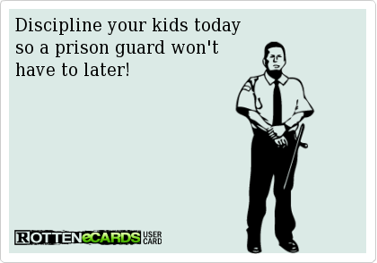

Slide 4
DISCIPLINE
“Discipline comes from discipulus, the Latin word for pupil, which also provided the source of the word disciple.”

Slide 5
DISCIPLINE
1. The practice of training people to obey rules or a code of behavior.
2. Using punishment, by way of correction and training, to correct disobedience.

Slide 6
3 Ways Discipline Occurs
1. Consequences to Disobeying
2. Loss of Privilege
3. Punishment (Rod) & Communication (Reproof)

Slide 7
Motivation Behind Discipline
1. We want it to go well with our kids. (Eph 6:1-3, Prov. 6:20-23)
2. Keep the kids in the Circle of Blessing.

Slide 8
Motivation Behind Discipline

Slide 9
Motivation Behind Discipline
1. We want it to go well with our kids. (Eph 6:1-3, Prov. 6:20-23)
2. Keep the kids in the Circle of Blessing.
3. Set Boundaries

Slide 10
Motivation Behind Discipline
To Save Them: “When we discipline our children, we are not merely trying to produce model subjects. We are trying to save them, by God’s grace, from themselves. The foolishness that is so deeply planted there must be rooted out.” Emily Schuch: How to Quietly Hate your Children.

Slide 11
3 Ways God Disciplines
1. Consequences to Disobeying
2. Loss of Privilege
3. Punishment & Communication (Reproof)

Slide 12
1.Proverbs 3:11-12 “My (child), do not reject the discipline of the Lord, Or loathe His reproof, For whom the Lord loves He reproves, Even as a father corrects the son in whom he delights.”
2. Psalm 94:12 – “Joyful are those you discipline, Lord, those you teach with your instructions.”
3. Proverbs 12:1 – To learn, you must love discipline; it is stupid to hate correction.
4. Proverbs 29: 15 – “The rod & reproof give wisdom, but a child left to himself brings shame to his mother.”
5. Proverbs 23:13-14” – “Do not hold back discipline from the child, Although you strike him with the rod, he will not die. You shall strike him with the rod. And rescue his soul from Sheol.”

Slide 13
DISCIPLINE
When you consistently disci­pline your child and do it with the right attitude — compassionately, under control, with consistent boundaries and consequences, and focused on the child's best outcome — you are expressing love exactly as God sometimes expresses His love. It may seem uncom­fortable both to you and your child at the time, but in the long run, it's the most selfless, compassionate thing you can do to set your child up for happiness in life and fruitfulness in God's Kingdom.” – Ingram (What the Bible says about Discipline: Focus on the Family).

Slide 14
3 Ways Discipline Occurs
1. Consequences to Disobeying
2. Loss of Privilege
- Time Outs
3. Punishment (Rod) & Communication (Reproof)
(Proverbs 13:24, 22:15, 23:14, 29:15)

Slide 15
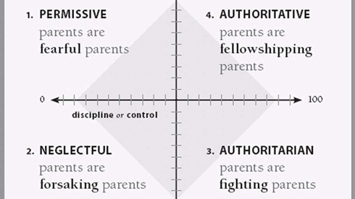
4 TYPES OF PARENTS

Slide 16
It is a Process
The problem and the struggle is that discipline is hard work and it is slow work. It is painful for them, and it is painful for us. Sometimes, it can be incredibly wearying. After disciplining for the same thing again and again, we might wonder, Is this producing anything? Are we getting anywhere? Will he ever learn?

Slide 17
It is a Process
“No matter how fruitless our efforts as parents seem at present, there is a harvest coming.”
So often, it can be tempting to take the easier way out, to let things go. It can make us feel like we are being more loving by being more lenient. The truth I find though is that this is usually nothing but my…

Slide 18
It is a Process
…selfishness masked as love. In the short term, it can be easier for me to forego discipline. When Proverbs 13:24 says that we must be diligent or careful to discipline, it means quite literally that we must take great care. It requires much of our time, commitment, patience, and faith.”

