Slide 1
Dealing with Episodes of Anger
Proverbs 29:22 An angry man stirs up strife, and a hot-tempered man abounds in transgression.
Ephesians 4:26 Be Angry, and yet do not sin: do not let the sun go down on your anger.

Slide 2
Proverbs 15:18 A hot-tempered man stirs up strife, but the slow to anger calms a dispute.
What prevents anger in children
What provokes children to anger
What is manipulation and disrespect which causes anger
How to avoid and contain angry encounters

Slide 3
Anger can be very scary, create great conflict and strife, and if not addressed and left to its own devices, will cause serious characterological issues.

Slide 4
We need to learn how to be “at rest” with our child/ren.
Psalm 131:2 But I have calmed and quieted my soul, like a weaned child with its mother; like a weaned child is my soul within me.

Slide 6
Not Weaned

Slide 7
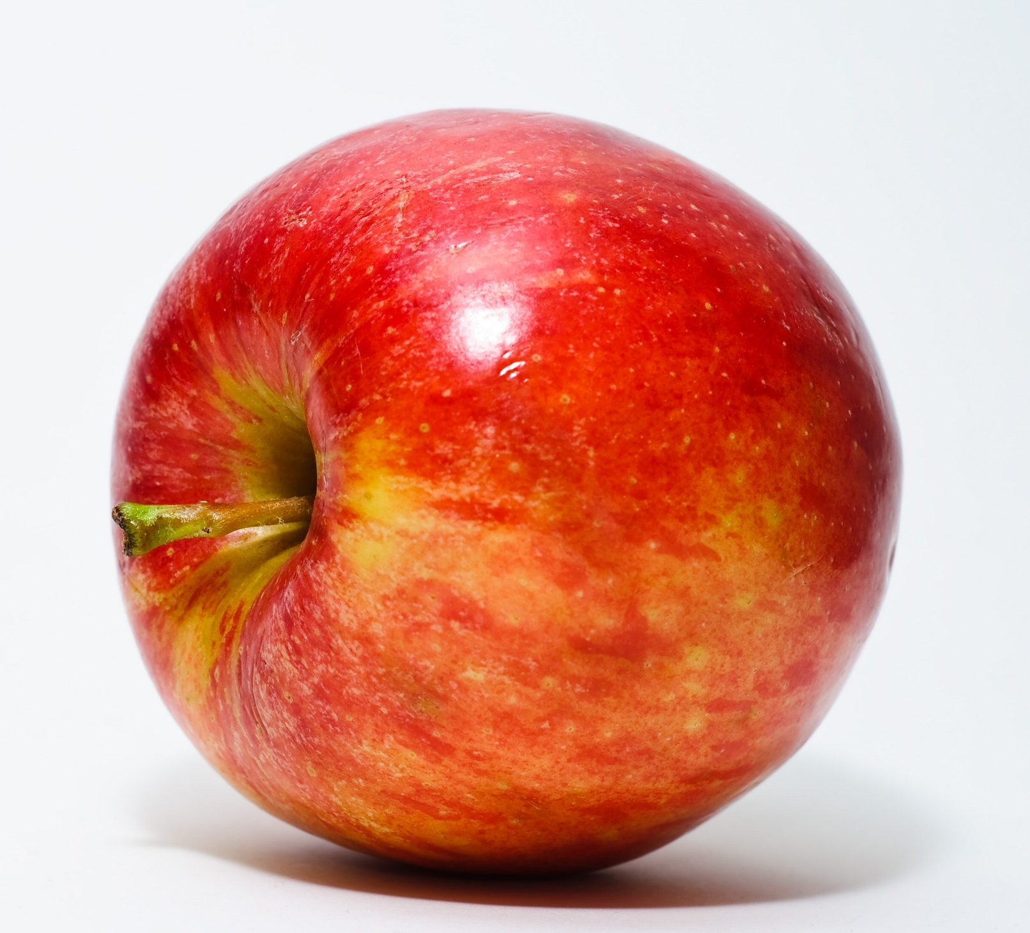
Weaned

Slide 8
The real relationship with a child does not begin with words, but in “being with”…
“You have made us for yourself O Lord, and our heart is restless until it finds rest in you.” Augustine of Hippo, Confessions
Proverbs 29:9 When a wise man has a controversy with a foolish man, the foolish man either rages or laughs, and there is no rest.
Matthew 11:28 Come to Me, all who are weary and heavy-laden, and I will give you rest.

Slide 9
Love - our godly connection with our child
Develop the capacity to be with the child in peace, to be overjoyed to be in the child’s presence
They sense our energy
They welcome our presence and desire to be with us more than their peers
Children need to be able to play in our presence under our protection
Hold your children with love - love is the glue
Loving and safe attachment to the parents is paramount
Consistency
Understanding
Meet needs, physical, social, emotional, intellectual and spiritual

Slide 10
What causes anger in children?
Sin – old man nature; child wants what he wants, when, where, and how he wants. Generally it is something that is selfish and lacks wisdom.
Lack of feeling safe and secure
An irregular schedule and not enough sleep
Poor hygiene and nutrition
Provoking a child to anger

Slide 11
Our goal is to teach them how to deal with emotions such as anger in a Christ-like way.

Slide 12
“Children learn early on that denial is a seemingly good way to protect themselves. Human nature is as such when children are told not to do something or to do something they do not want to do, they react. When children are held accountable or responsible for their behavior, they react in a similar way. They cry, scream, and throw themselves down; some hit their heads on the floor. What they say in this state of mind is meant to hurt their parents and to redirect attention away from their wrong behavior. “I hate you.” “You don’t love me.” “You are not a good mommy.” “You are mean.” These emotional outbursts are human nature attempting to avoid obedience and responsibility. Good parents do not buy into this nonsense but stand their ground and help the children to mature by shouldering responsibility. If a person does not learn to accept the responsibility of his or her wrong doings, he or she will grow into an irresponsible adult who blames anybody or anything for his or her own wrong behavior. Such a soul is trapped.

Slide 13
Continued…
Denial has many faces for masking our sins and problems. It appears in different ways and operates in various fashions. Denial serves as our primary survival skill but actually produces the opposite result – continued slavery. We “protect” ourselves by not admitting that anything is wrong. We ignore the real problems by replacing them with a host of elaborate explanations, rationalizations, and distractions such as minimizing, blaming, excusing…
The beginning of freedom is admitting the problems and stopping the excuses.”
Finnegan, Vince, Surrender and Take Control, pp. 38, 39.

Slide 14
Fathers, do not provoke your children to anger, but bring them up in the discipline and instruction of the LORD. Eph. 6:4
1. Marital harmony Gen. 2:24
2. God-centered home not child-centered
3. Angry behavior modeled by parents Prov. 22:24,25
4. Habitually disciplining child while angry yourself – over disciplining
5. Scolding – angry snorting
6. Inconsistent with discipline 1 Cor. 1:17, 18
7. Having double standards, hypocrisy

Slide 15
8. Being legalistic
God’s laws
Honor parents
Do not covet
Be kind, tenderhearted one to another
No lying, stealing
Love God, neighbor, self, etc.
Rules of the home
Bedtime
Schedule
Chores
Allowances
Dating age, etc.

Slide 16
9. Not admitting you are wrong or asking for forgiveness
10. Consistently finding fault, criticizing
11. Not listening to your child’s rational opinions or ideas
12. Comparing them to others in a negative way
13. Not taking time to just talk or be with child/teen

Slide 17
14. Failing to keep your promises causes:
Disappointment and discouragement
Suspicion and cynicism, unwillingness to trust
Rejection – hurt feelings
Bitterness and resentments
Loss of respect or contempt for parents
Thoughts of being unloved

Slide 18
15. Not allowing enough freedom or giving too much freedom
16. Mocking the child Job 17:1, 2
17. Abusing them physically
18. Ridiculing and name calling Eph. 4:29
19. Unrealistic expectations

Slide 19
A disrespectful and manipulative child will be an angry child, teen, and adult

Slide 20
Child/teen acting out… (or maybe parent too?)
Being Harsh – Prov. 15:1
Biting sarcasm
Raising voice, i.e. yelling I Tim. 3:2-3
Profanity
Name calling
Throwing, kicking, hitting things – or others
False accusations Ex. 20:16
Criticism James 4:11-12
Pouting or Sulking

Slide 21
The Behavior of Child | Desired Emotional Response | Parental Reaction | Desired Controlling Effect | Sinful Motives of Child
Accusations | Guilt | Defend self | To procrastinate | Love of pleasure
Criticisms | Shame | Justify actions | To avoid obligation | Love of power
Crying | Embarrassment | Blame shifting | To change parent’s mind | Love of praise
“Why” questions | Hurt | Answer “why” questions | To lower parents’ standard | Love of power
Obligatory Statements | Anger | Yelling back | To rescind parental punishment | Love of power, love of self

Slide 22
Chart continued
Sulking/pouting
Whining
Withholding affection
Cold shoulder
Telling parent it is all parent’s fault
Love of whatever it is that the child wants more than obeying God.

Slide 23
Examples of being manipulated
Parent: It is time to clean your room. Please take this time to go clean it now.
Alan: But it is not dirty!!!
Parent: Yes it is!
Alan: You’re always wanting me to clean my room!!
Parent: I do not!!
Alan: You never keep your room clean. You didn’t even make your bed today!!!
Parent: You don’t have half the responsibilities I have in a day. Go clean your room.
Alan: My friends don’t have to clean their rooms! Their parents are cool.
Parents: That may be true, you don’t live with them, you live with us.

Slide 24
Alan: Why is it so important to you that I clean my room?
Parent: Because it is a house rule, I’m your parent and I told you to do it.
Alan: Oh, all right. I’ll do it after dinner.
Parent: You’ll do it now!
Alan: But my friend is coming over now. I can’t.
Parent: You’ll do it now or you won’t be going anywhere for 2 weeks!!!!
Alan: (Mumbles something and stomps off to room.)

Slide 25
How do we respond to angry outburst, manipulative behavior and disrespect?
Be on the alert to not get drawn into the foolish conversation.
Bring child’s mind to the Word – this is always the standard for parent and child. Speak Scripture to the foolishness. 2 Tim 3:16
Parent: It is time to clean your room. Please take this time to go clean it now.
Alan: But it is not dirty!!!
At this point the Parent was lured into the verbal snare…
If room is actually clean, Alan can respectfully tell the parent he cleaned it already. “I understand that you want me to clean my room, but I did it earlier today.”
Parent: I have seen your room just a few minutes ago and it is not clean. You are trying to get out of doing what you are asked to do.

Slide 26
Alan: Oh, all right. I’ll do it after dinner.
Parent: You’ll do it now! Parent gets caught in the trap of speaking to a fool and becomes a fool!!
Alan: But my friend is coming over now. I can’t.
Parent: You’ll do it now or you won’t be going anywhere for 2 weeks!!!! Threats and punishment.
Parent: How about you stop this behavior and just go to your room and get it done. You would be half done by now. After you are done you can play with your friend.
Parent: I need to remind you to obey God’s Word and obey your parent in the Lord. Anger just stirs up strife. Think about how good your room will look and that you will be pleasing to God and to me.
If child continues, just state that he will do as you ask and that you are done discussing it. (Depending on child’s age you may assist to help teach how to do this and to engage with the child.)

Slide 27
We tend to go for the “jugular” quickly.
We tend to go for the punishment too quickly.
We tend to escalate punishments until the child is hardened and it takes more and more punishment to achieve any results, especially in a strong willed child. Or
We punish the child too harshly and break their sense of self.
We get out of control due to getting emotional rather than having the peace of God.
***Instead – get a grip on yourself and appeal to personal responsibility at age appropriate behavior.

Slide 28
Discipline child to be a disciple.
From a place of peace and calm with God, loving your child (who is considered a fool from God’s perspective), we are to teach and train our children to obey us - and in doing so, will learn to obey God.
Possibly more importantly, your son or daughter will learn how to be at rest and live in a love relationship with God and Jesus Christ for the child/teen’s life.

Slide 29
1 John tells us that love and obedience are one in the same.
A child/teen will get angry due to many reasons. Talk and find out the reasons and teach the child skills in how to deal with the problem.
Nurturing with an easy presence and authority, and being clear and consistent in your discipline will help train the child to love and obey Yahweh and Christ.

Slide 30
Children are an added blessing.

Slide 31
Children obey your parents in the Lord…so that it may be well with you and you live a long life. Eph. 6:1,3

