Slide 1
Balancing Oversight With Independence

Slide 3
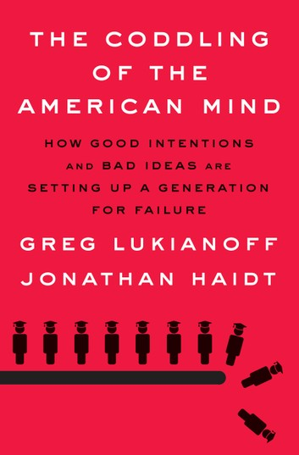
“By the early 1990s the program had spread, and photos of missing children were reproduced on grocery bags, billboards, pizza boxes, even utility bills. Norms changed, fears grew, and many parents came to believe that if they took their eyes off their children for an instant in any public venue, their kid might be snatched. It no longer felt safe to let kids roam around their neighborhoods unsupervised.”
Greg Lukianoff and Jonathan Haidt, Coddling of the American Mind (NY: Penguin Books 2018), p. 166.

Slide 4
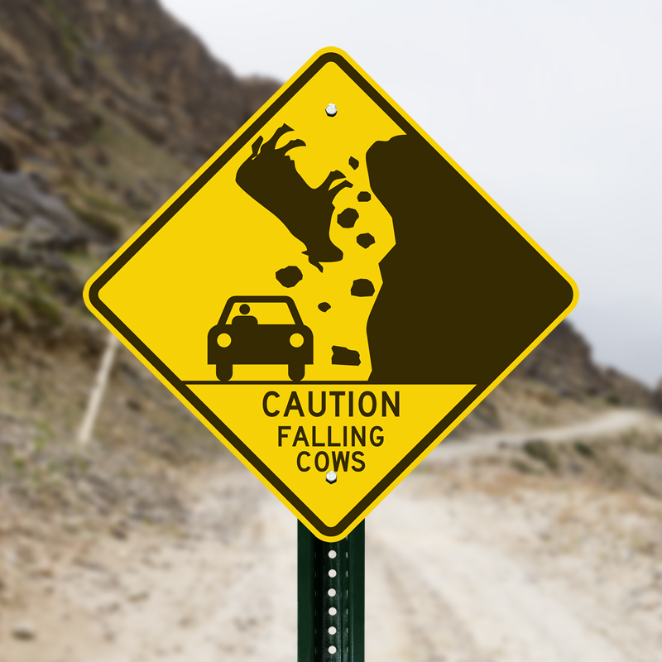
“safteyism”
overestimates danger
assumes the worst will happen
eliminates all risk

Slide 9
“Nevertheless, the fear of crime did not diminish along with the crime rate, and the new habits of fearful parenting seem to have become new national norms. American parenting is now wildly out of sync with the actual risk that strangers pose to children.”
Greg Lukianoff and Jonathan Haidt, Coddling of the American Mind (NY: Penguin Books 2018), p. 167.

Slide 11
Paranoid Parenting Teaches:
the world is a scary place I cannot face alone
I’m fragile and in need of constant protection from an adult or an institution
people outside of my circle of trusted adults are dangerous
I’m the center of the world
my emotions and needs determine reality not those of my parents or others (I’m the most important person in the room)

Slide 12
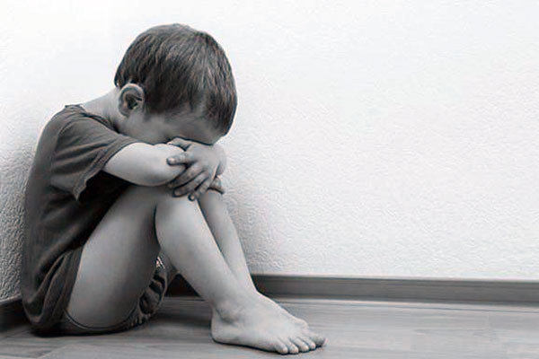
they’re too busy
neglect kids
too much freedom
expose them to instability
b/c of lack of supervision they encounter sexual content, drugs, crime, etc.
they experience chronic stresses that are toxic and can cause lasting damage rather than building resilience
These kids leave the nest prickly and struggle to maintain relationships at work, with authority figures, with romantic partners, and with their own kids.

Slide 13
How do I balance oversight with independence?

Slide 14
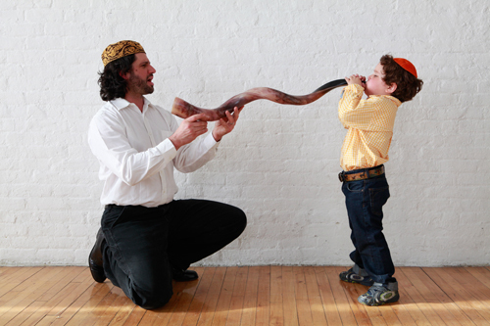
“A father's responsibilities to his son are outlined in the Talmud, Kiddushin 29a. According to the text, a father is obligated to circumcise his son, to redeem him if he is the firstborn, to teach him Torah, to find him a wife, and to teach him a trade. Talmudic scholars added that a father must also teach his son to swim.”
Rabbi Victor Appell from reformjudaism.org

Slide 15
Matthew 11.16-17
“But to what shall I compare this generation? It is like children sitting in the marketplaces and calling to their playmates, "'We played the flute for you, and you did not dance; we sang a dirge, and you did not mourn.’”

Slide 16
1 Samuel 17.12ff

Slide 19
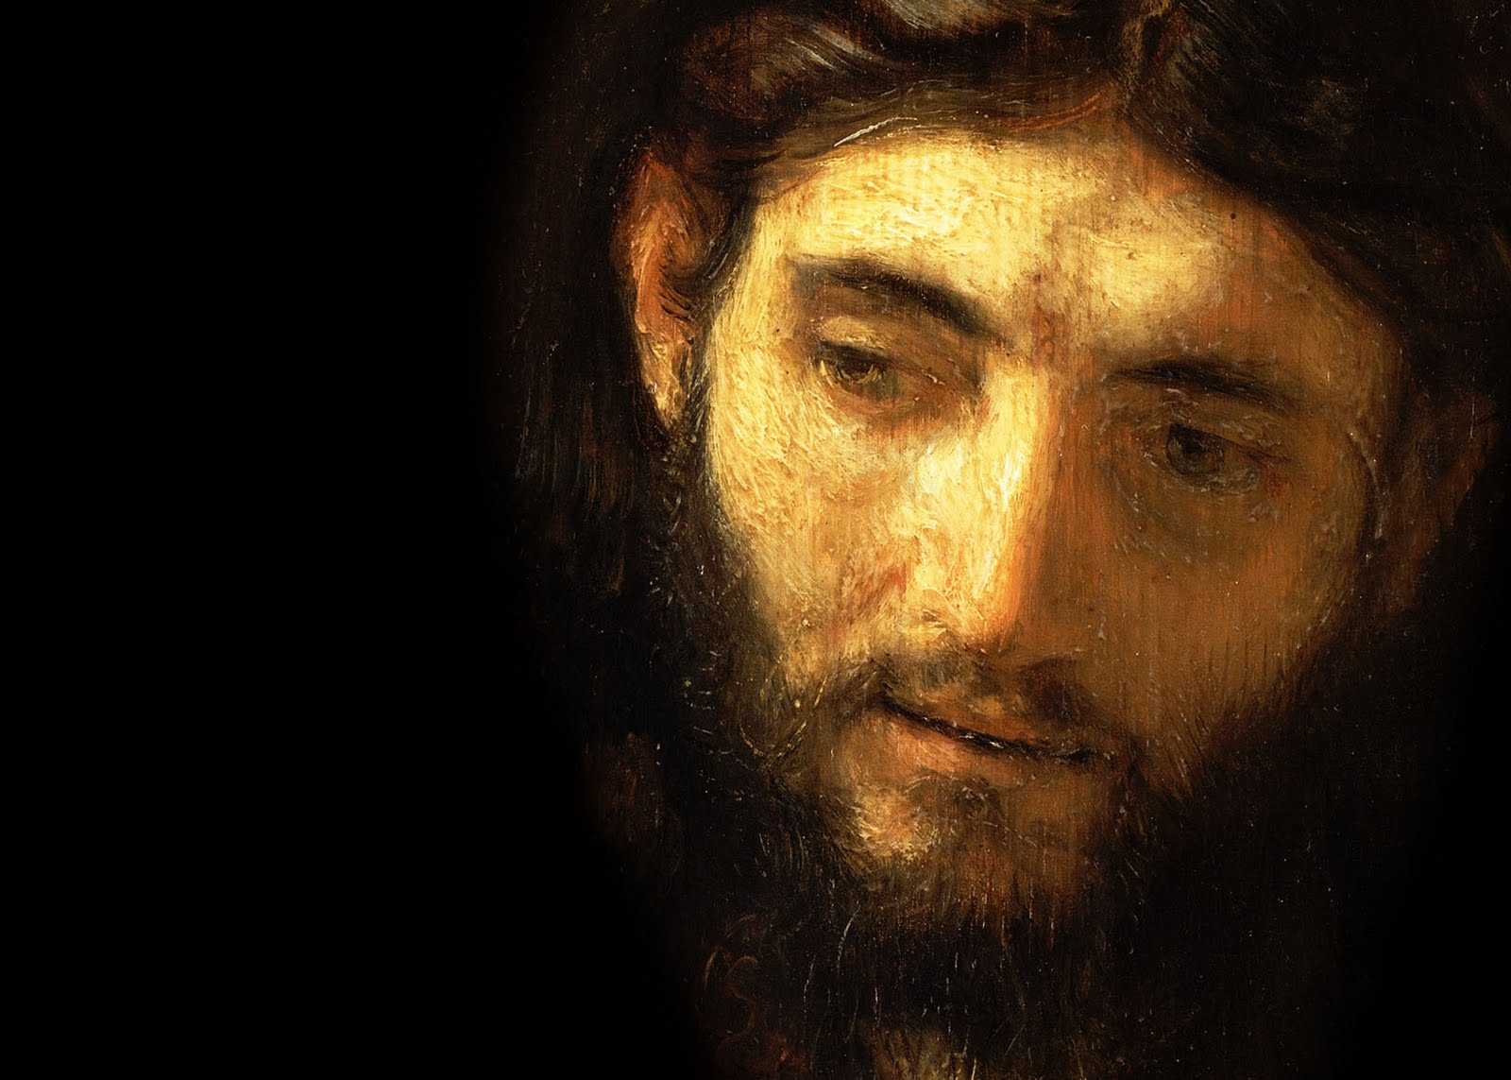
Luke 16.10-12
10 "One who is faithful in a very little is also faithful in much, and one who is dishonest in a very little is also dishonest in much. 11 If then you have not been faithful in the unrighteous wealth, who will entrust to you the true riches? 12 And if you have not been faithful in that which is another's, who will give you that which is your own?

